Slide 1


Department of Computer Science and Engineering
CS19P11 – IOT
VOICE CONTROL ROBOT
Hari Amerthesh N -210701067
Hemanth Kumar D -210701083
Karthikeyan C -210701111

Slide 2
Problem Statement and Motivation
The increasing demand for smarter and more efficient home and workplace environments highlights the need for a versatile and user-friendly solution to automate routine tasks and enhance connectivity between devices. The problem lies in the limited integration of voice-controlled systems with IoT, which often results in fragmented and inefficient operations. This project is motivated by the vision to create a cohesive robotic system that seamlessly interprets and executes voice commands, leveraging IoT to connect and control various smart devices. By addressing these challenges, the project aims to improve user convenience, enhance operational efficiency, and set a new standard for intelligent home and workplace automation.

Slide 3
Objectives
The objective of the voice control robot project using IoT is to develop an intelligent robotic system that seamlessly interacts with users through voice commands, leveraging IoT for enhanced connectivity and functionality. This includes implementing advanced speech recognition for accurate real-time command interpretation, integrating IoT capabilities to connect with various smart devices, and designing the robot to perform a wide range of tasks such as household chores, security, and monitoring. The project aims to create a user-friendly interface accessible to all, utilize IoT for data collection and intelligent decision-making, ensure safety and reliability with robust security measures, and provide a scalable and flexible system that can be easily upgraded with new functionalities as technology evolves.

Slide 4
Abstract
This project presents a versatile voice-controlled robot designed for multiple applications, leveraging advanced speech recognition technologies to enable seamless human-robot interaction. The robot's adaptable framework allows it to perform a wide range of tasks, from domestic chores and personal assistance to security surveillance and educational support. The robot can understand and execute complex voice commands with high accuracy, ensuring user-friendly operation and enhancing efficiency in various environments. This innovation not only aims to improve everyday life but also demonstrates the potential for future advancements in autonomous robotic systems and smart home technologies.

Slide 5
Components Used
Arduino Uno Board
Arduino Cable
Motor Driver Module (L293D)
Motors - 2
Robot Chassis
Caster Wheel
Wheels - 2
Bluetooth module (HC-05)
Connecting wires
9V battery and connector
Android App - BT Voice Control for Arduino (Google Playstore)

Slide 6
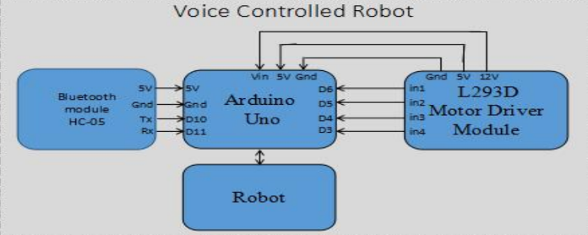
Block Diagram

Slide 7
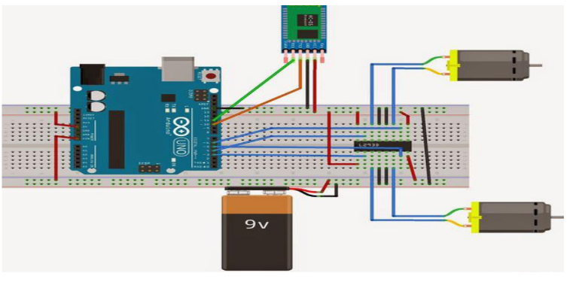
Circuit Diagram

Slide 8
Final Output/Result

Slide 9
Conclusion
In conclusion, the development of a voice-controlled robot utilizing IoT capabilities represents a significant advancement in the realm of intelligent automation for home and workplace environments. By seamlessly integrating advanced speech recognition with robust IoT connectivity, this project addresses the limitations of current systems, providing a versatile and user-friendly solution for a wide range of applications. The successful implementation of this technology promises to enhance user convenience, operational efficiency, and overall quality of life, setting a new benchmark for future innovations in smart automation and robotics. This project not only meets current demands but also paves the way for ongoing improvements and adaptations in an ever-evolving technological landscape.

Slide 10
Future Enhancement :
Future enhancements for the voice-controlled robot utilizing IoT include integrating more sophisticated AI and machine learning algorithms to improve performance through user interaction, and upgrading natural language processing to handle complex and multi-lingual commands. Expanding IoT integration to support a wider range of smart devices will ensure seamless interoperability, while incorporating augmented reality (AR) features can provide real-time visual feedback for intuitive control. Enhanced security measures will protect user data, and advancements in autonomous navigation will allow the robot to move efficiently in various environments. Energy-efficient technologies will extend operational lifespan, modular components will enable easy upgrades, and collaborative multi-robot systems will enhance productivity. Continuous refinement of the user interface based on feedback will ensure accessibility and user satisfaction.

Slide 11
Thank You

